Slide 1
데이터 기사화 고급 Folium&Yellowbrick소개

Slide 2
데이터 시각화 고급 도구
Plotly
https://plotly.com/
Matplotlib
https://matplotlib.org/
Bokeh
https://docs.bokeh.org/
Seaborn
https://seaborn.pydata.org/
Yellowbrick
https://www.yellowbrick.com/
Folium
https://python-visualization.github.io/folium

Slide 3
Folium
사이트
https://python-visualization.github.io/folium/
설치
Pip install folium
특징
지도 시각화 라이브러리
Pandas 와 연동이 쉬움

Slide 4
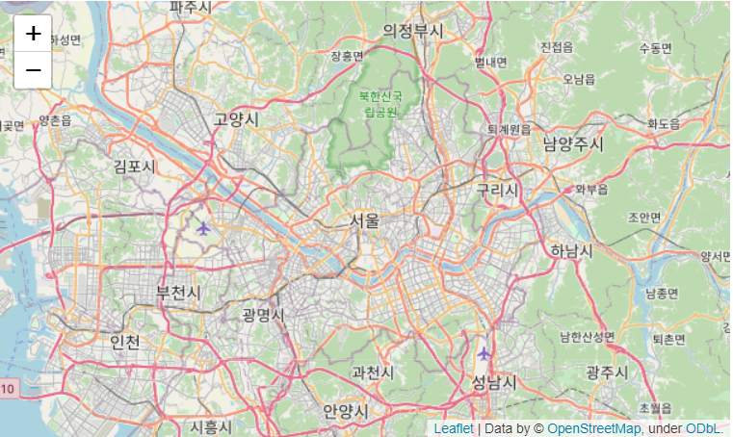
지도 생성하기
import folium
import pandas as pd
map_osm = folium.map(location=[37.566647, 126.978426])
map_osm

Slide 5
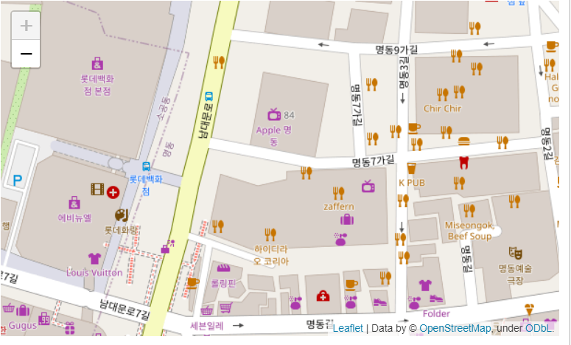
지도 생성하기
import folium
import pandas as pd
map_osm = folium.Map(location=[37.566647, 126.978426], zoom_start=17)
map_osm
takes an integer (0-18)

Slide 6
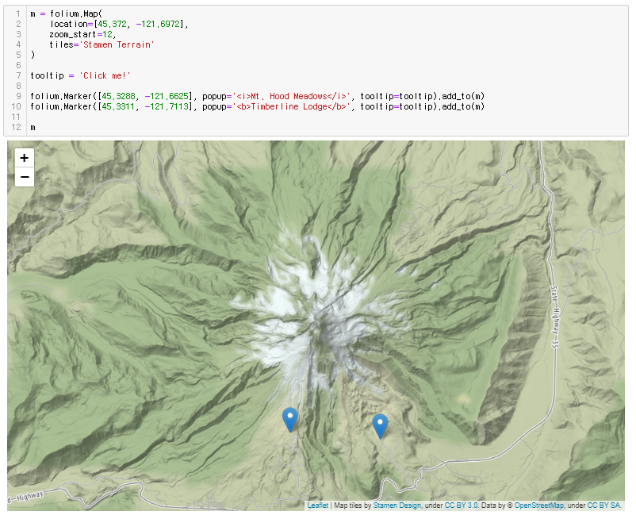

Slide 7
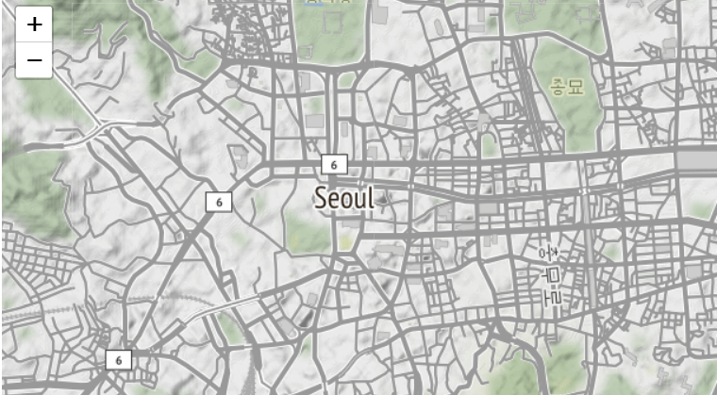
지도 생성하기
import folium
import pandas as pd
map_osm = folium.Map(location=[37.566647, 126.978426], zoom_start=17, tiles = ‘Stamen Terrain’)
map_osm
tiles: Stamen Terrain, Stamen Toner, CartoDB dark_matter (title slide)

Slide 8
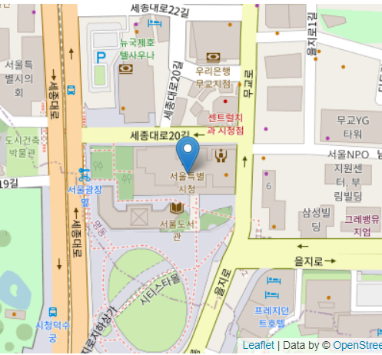
마커 추가하기
import folium
import pandas as pd
map_osm = folium.Map(location=[37.566647, 126.978426], zoom_start=17)
marker = folium.Marker([37.566647,126.978426])
marker.add_to(map_osm)
map_osm

Slide 9
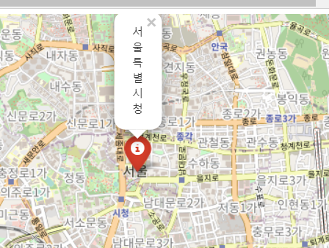
마커 추가하기
import folium
import pandas as pd
map_osm = folium.Map(location=[37.566647, 126.978426], zoom_start=17)
marker = folium.Marker([37.566647,126.978426], popup='서울특별시청', icon=folium.Icon(color='red’))
marker.add_to(map_osm)
map_osm
마커를 클릭하면 나타남

Slide 10
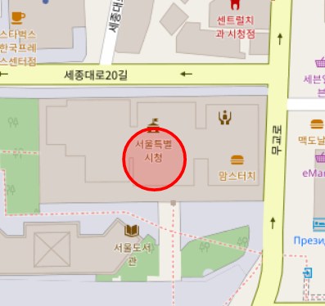
Circle 마커 추가하기
import folium
import pandas as pd
map_osm = folium.Map(location=[37.566647, 126.978426], zoom_start=17)
marker = folium.CircleMarker([37.566647,126.978426],
popup='서울특별시청', radius=30,
color="red", fill=True)
marker.add_to(map_osm)
map_osm
radius: circle의 크기를 제어하는 실수값
fill: Boolean indicating whether or not to color in circle

Slide 11
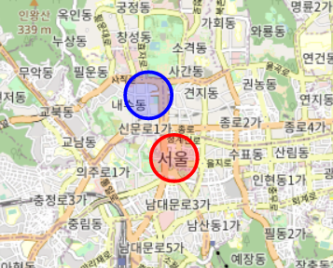
Creating Map – Add Circle Marker
두개 Circle 마커 추가하기
map_osm = folium.Map(location=[37.566647, 126.978426], zoom_start=17)
marker = folium.CircleMarker([37.566647,126.978426],
popup='서울특별시청', radius=20,
color="red", fill=True)
marker.add_to(map_osm)
marker = folium.CircleMarker([37.5740381,126.9745863],
popup='광화문', radius=20,
color="blue", fill=True)
marker.add_to(map_osm)
map_osm

Slide 12
import folium m = folium.Map( location=[36.5053542,127.7043419], zoom_start=8 ) lotto = [ {"store":"담배","loc":[37.62585944357624,127.01847823823798]}, {"store":"화곡본마트","loc":[37.54248103738589,126.84414659211494]}, {"store":"용꿈돼지꿈","loc":[37.5447438346992,126.95223862043447]}, {"store":"일이오마켓","loc":[37.47943673430032,126.98346178441342]}, {"store":"여명슈퍼마켓","loc":[37.61432815661055,127.0415039221072]}, {"store":"5가로또레드탑","loc":[37.570756251987575,127.00235901546226]}, {"store":"복권세상","loc":[35.91885025656432,128.55034430109828]}, {"store":"복권전문점","loc":[37.50384327747725,126.71513104367074]}, {"store":"인현동지하가판","loc":[37.47627910055104,126.63147671205866]}, {"store":"CU(광주서동점)","loc":[35.14814807640179,126.90555219336346]}, {"store":"지산로또방","loc":[35.148338888178,126.93203920504686]}, {"store":"천사로또방","loc":[37.63618838692431,127.21107884503209]}, {"store":"오렌지통신","loc":[37.42889361993242,127.10232604117991]}, {"store":"여수복권방","loc":[37.418353650942116,127.12640523182601]}, {"store":"둘리복권방","loc":[37.34532813934063,126.73627994929885]}, {"store":"금성24시편의점","loc":[37.84401249737699,127.06236893072152]}, {"store":"GS25(청주주은점)","loc":[36.60987111587086,127.49134026856717]}, {"store":"장미슈퍼","loc":[36.276304155315685,126.90940713047799]}, {"store":"장미슈퍼","loc":[36.276304155315685,126.90940713047799]}, {"store":"아이24(수송점)","loc":[35.970108052787594,126.7189421934312]}, {"store":"탑로또","loc":[34.87844231008963,128.62803523643754]} ] from folium.plugins import MarkerCluster marker_cluster = MarkerCluster().add_to(m) for i in range(len(lotto)): folium.Marker( location=lotto[i]['loc'], popup=lotto[i]['store'], icon=folium.Icon(color='red',icon='ok'), ).add_to(marker_cluster) m.save('map.html')

Slide 13
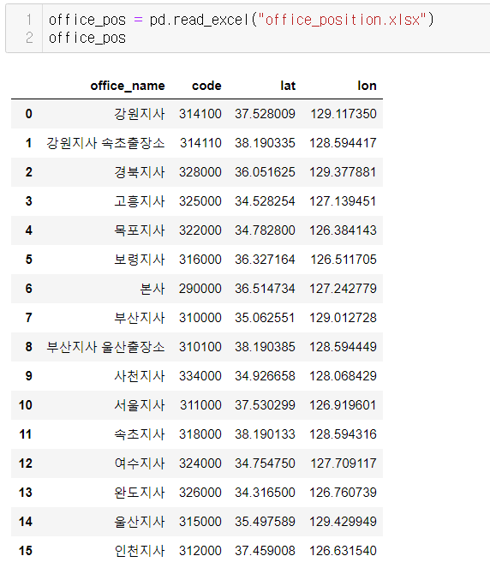
위치 정보 하기

Slide 14
Creating Map – Add Circle Marker
다중 마커 추가하기
map_osm = folium.Map(location=[36.514734,127.242779], zoom_start=17)
num_offices = office_pos.shape[0]
for i in range(num_offices):
lat = office_pos.lat[i]
lon = office_pos.lon[i]
name = office_pos.office_name[i]

Slide 15
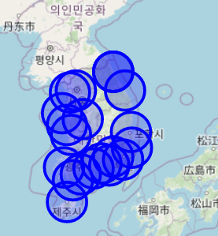
Creating Map – Add Circle Marker
다중 마커 추가하기
map_osm = folium.Map(location=[36.514734,127.242779], zoom_start=17)
num_offices = office_pos.shape[0]
for i in range(num_offices):
lat = office_pos.lat[i]
lon = office_pos.lon[i]
name = office_pos.office_name[i]
folium.CircleMarker(location=[lat, lon],
popup=name, radius=20,
color="blue", fill=True).add_to(map_osm)
map_osm

Slide 16
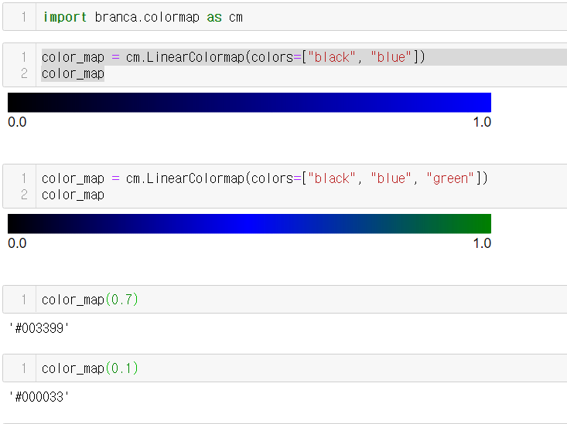
Creating Map – Add Circle Marker
컬러 맵 추가하기

Slide 17
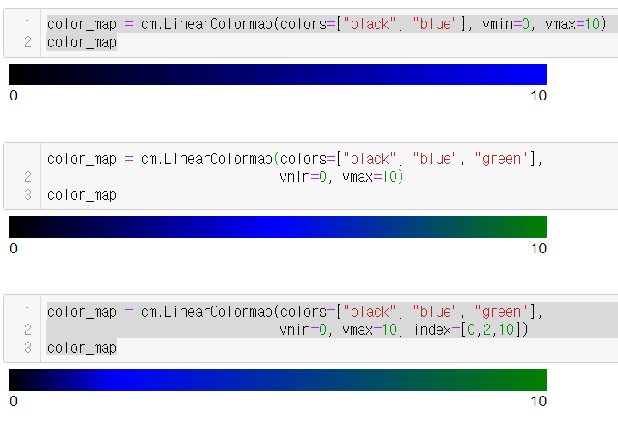
컬러 맵 추가하기

Slide 18
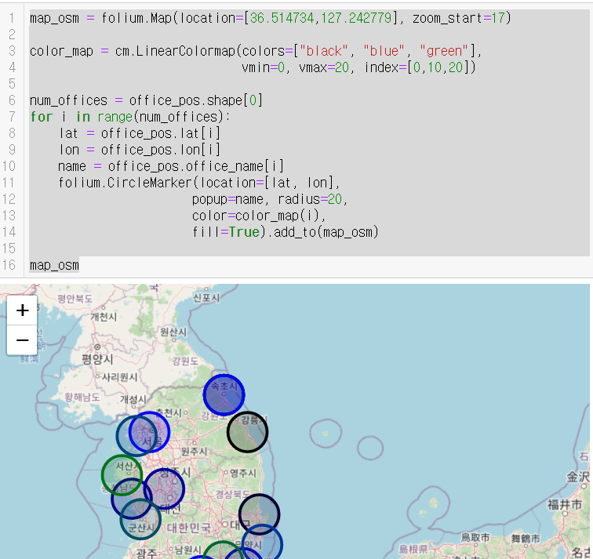
컬러 맵 추가하기

Slide 19
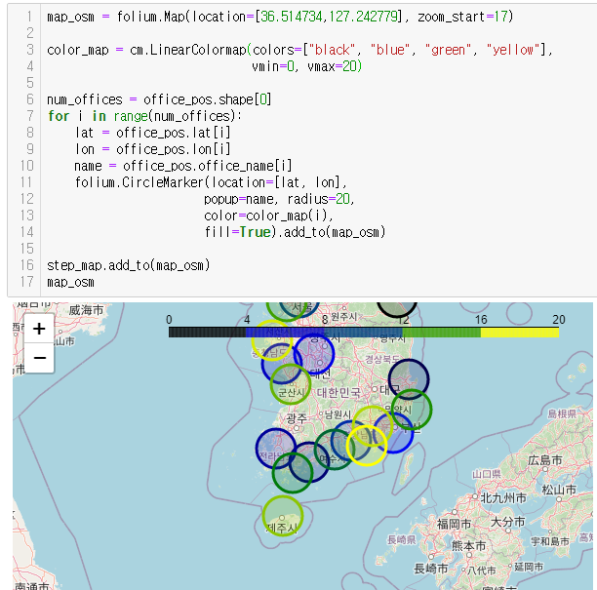
컬러 맵 기반 지도 그리기

Slide 20
JSON 파일
{"type":"FeatureCollection","features":[{"type":"Feature","properties":{"code":"39","name":"제주특별자치도","name_eng":"Jeju-do","base_year":"2013"},"geometry":{"type":"MultiPolygon","coordinates":[[[[126.95749379078595,33.52245641407977],[126.97319896844937,33.49875407762396],[126.96872405188999,33.48622329800168],[126.94954584505405,33.489544759407586],[126.94279608185538,33.50103054305068],[126.95749379078595,33.52245641407977]]],[[[126.7825845509244,33.56393550760943],[126.8018582544952,33.55370235630926],[126.82997198813513,33.556850838139745],[126.8331417008612,33.543008206660225],[126.85956040109559,33.523745962792475],[126.87389326757639,33.528409852451844],[126.90448695242354,33.52306487302841],[126.91799070614931,33.49833730982538],[126.90673163147841,33.48381434309957],[126.91451306459106,33.46996423357717],[126.93834260745915,33.47055272719846],[126.94220969441905,33.459025579395615],[126.92858555273448,33.4491472596985],[126.91017277433778,33.40261068722996],[126.90919306804297,33.38792556762759],[126.89301691675155,33.3836055817056],[126.8753588258309,33.36822409289375],[126.87055011623951,33.349751598527895],[126.84671810773915,33.33005904395919],[126.85138930298508,33.322330915913305],[126.8380596329972,33.30541883093071],[126.81058128763874,33.29810905769377 ……

Slide 21
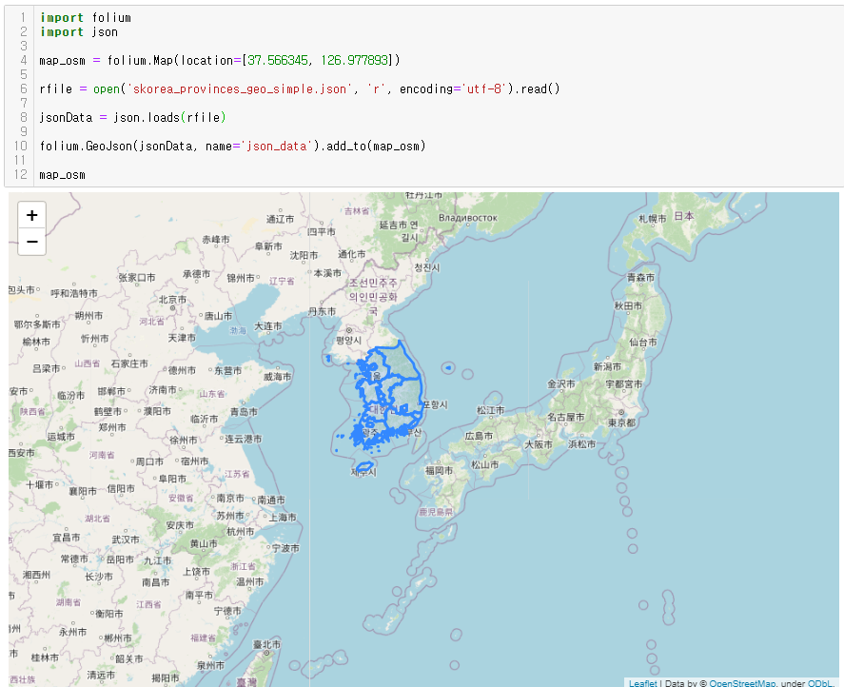
JSON 파일

Slide 22
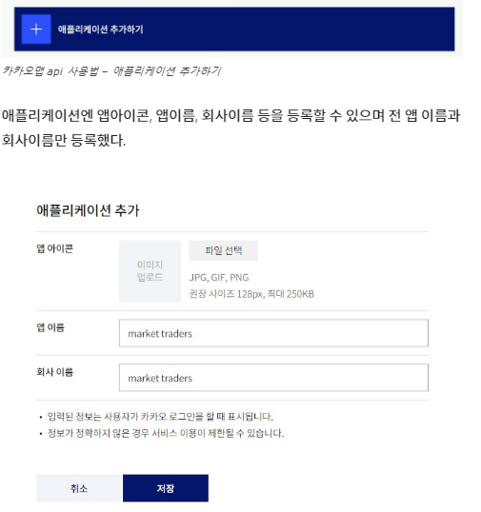
주소 기반 지도 그리기
카카오맵을 사용하기
https://developers.kakao.com/

Slide 23
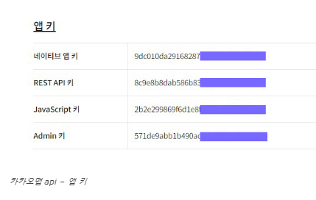

Slide 24
import requests
import json
import folium
searching = '거진항'
url = 'https://dapi.kakao.com/v2/local/search/keyword.json?query={}'.format(searching)
headers = {
"Authorization": "KakaoAK 90d17afd1f58d1c66d60678f2b1c7f21"
}
places = requests.get(url, headers = headers).json()['documents']
result = json.loads(str(requests.get(url, headers=headers).text))
result

Slide 25
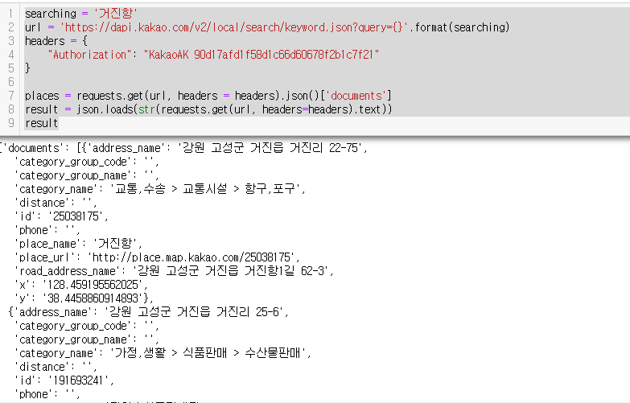

Slide 26
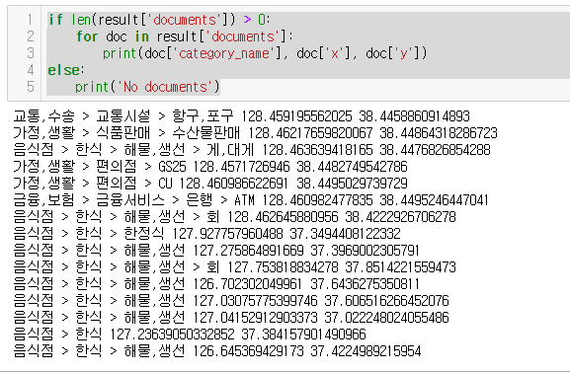

Slide 27
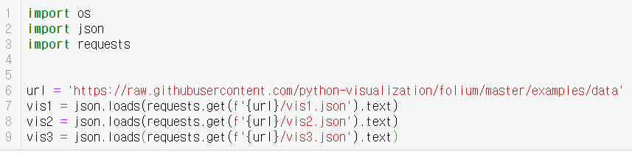
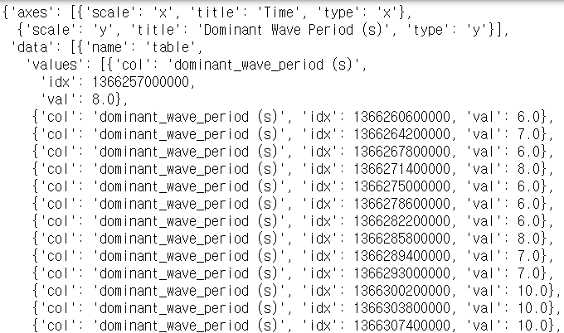

Slide 28
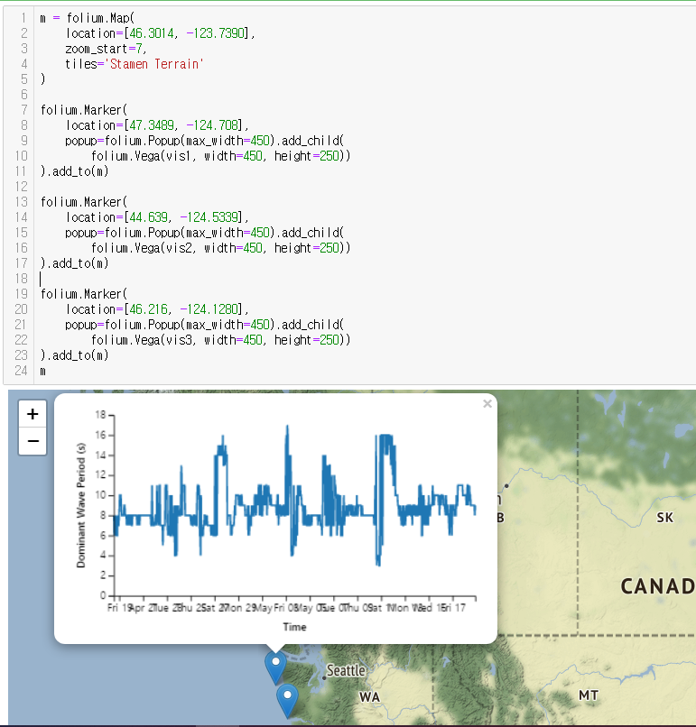

Slide 29
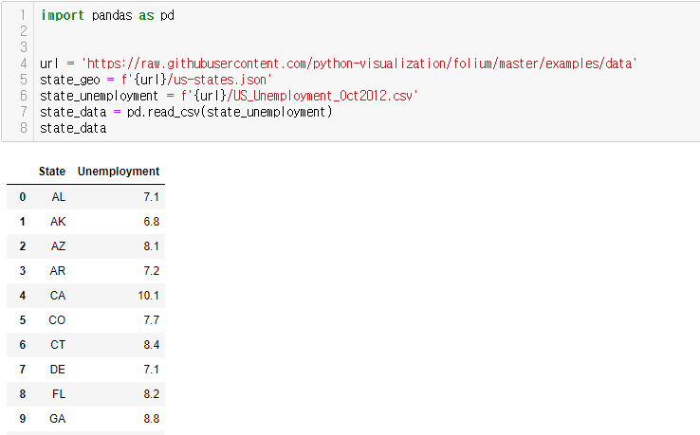

Slide 30
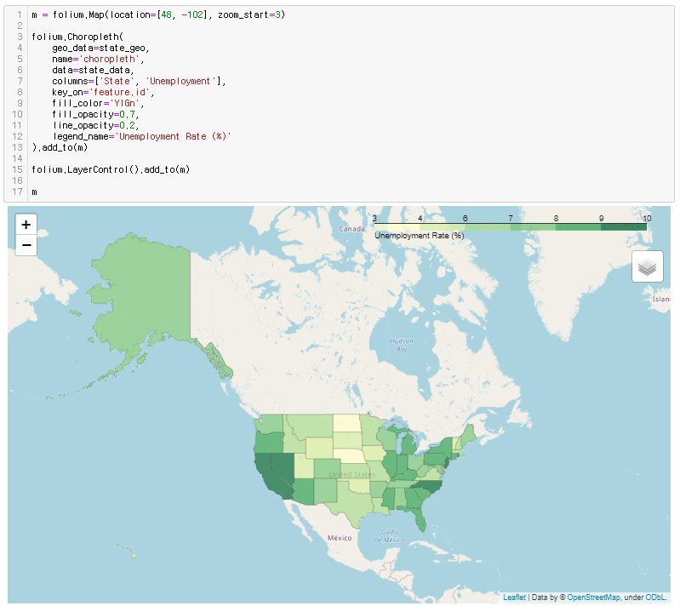

Slide 31
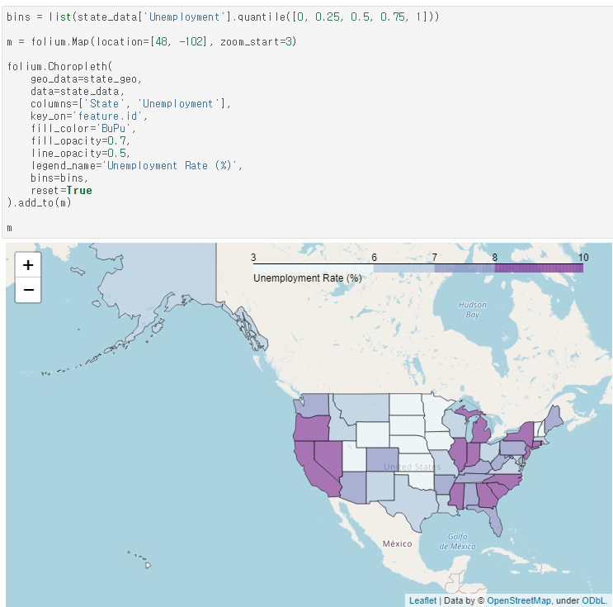

Slide 32
감사합니다.

